Slide 1
Operating Systems
Chapter 1
Introduction
Hammad Afzal
hammad.afzal@mcs.edu.pk
Computer Science Department
College of Telecommunication Engineering
National University of Sciences and Technology

Slide 2
Agenda
Course Details
Grading Policy
Course Contents
Chapter 1
Introduction to Operating Systems

Slide 3
Resources
Lecture Slides will be available on LMS
Quizzes and Assignments will be loaded on LMS.
Additional references shall be provided (if any)
Text Book:
1. Operating System Concepts by Abraham Silberchatz.
Reference:
Operating Systems: Internals and Design Principles, 5-6/E William Stallings

Slide 4
Grading Policy
Assignments 10%
Quizzes 10%
Mid Terms 30%
End-term 50%
Assignments
Quizzes
Mostly announced
Occasionally unannounced

Slide 5
Assignment Policies
No late work will be accepted (unless arrangements have been made in advance)

Slide 6
Policies – Attendance
Deficiency in attendance may lead to termination or relegation

Slide 7
Policies
Check your email regularly for messages
Course Mailing Group:
http://groups.google.com/group/bese15_os
Course senior to make sure that students subscribe to the group for announcements.

Slide 8
Course Outline
Operating System
Process Management
Concept
Multithreaded Programming
Process Scheduling
Process Co-ordination
Synchronization
Deadlocks
I/O Systems
Memory Management
File System
Introduction to Network & Distributed O/S

Slide 9
Lecture Objectives
To provide a grand tour of the major operating systems components

Slide 10
Chapter 1: Roadmap
Operating System Concepts
Computer-System Organization
Computer-System Architecture
Operating-System Structure
Operating-System Operations
Process Management
Memory Management
Storage Management

Slide 11
What is an Operating System?
A program that acts as an intermediary between a user of a computer and the computer hardware
Operating system goals:
Make the computer system convenient to use: makes hardware useful to the programmer
Provides abstractions for applications: Manages and hides details of hardware; Accesses hardware through low/level interfaces unavailable to applications
Provides protection: Prevents one process/user from clobbering another
Execute user programs and make solving user problems easier

Slide 12
What Operating Systems Do
Depends on User Point of View
Single Users Systems
Users want convenience, ease of use
Don’t much care about resource utilization
Shared computer
Users sits on terminals connected to mainframe
Other users connected to same computer.
Designed to maximize resource utilization
Dedicated systems such as workstations have dedicated resources but frequently use shared resources from servers
Some computers have little or no user interface, such as Embedded computers in devices and automobiles

Slide 13
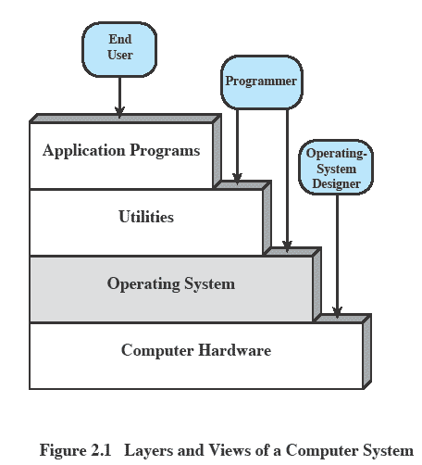
Layers and Views
Notes:
The hardware and software used in providing applications to a user can be viewed in a layered or hierarchical fashion, as depicted here.
The user of those applications, the end user, generally is not concerned with the details of computer hardware.
The end user views a computer system in terms of a set of applications.
An application can be expressed in a programming language and is developed by an application programmer.
If one were to develop an application program as a set of machine instructions that is completely responsible for controlling the computer hardware, one would be faced with an overwhelmingly complex undertaking.
The most important collection of system programs comprises the OS.
The OS masks the details of the hardware from the programmer and provides the programmer with a convenient interface for using the system.
It acts as mediator, making it easier for the programmer and for application programs to access and use those facilities and services.

Slide 14
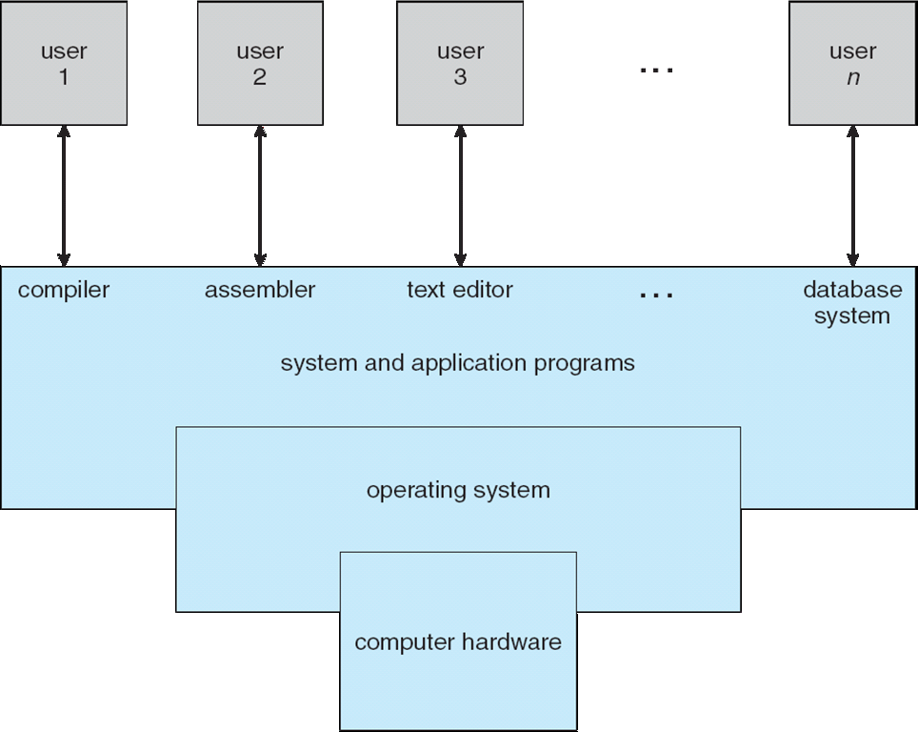
Components of a Computer System

Slide 15
Operating System Definition
OS is a resource allocator
Manages all resources
Decides between conflicting requests for efficient and fair resource use
OS is a control program
Controls execution of programs to prevent errors and improper use of the computer
Notes:
A computer is a set of resources for the movement, storage, and processing of data.

Slide 16
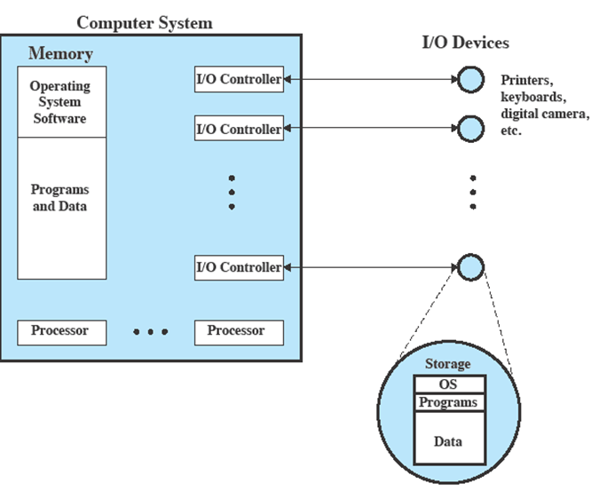
OS as Resource Manager
Notes:
This figure suggests the main resources that are managed by the OS.
A portion of the OS is in main memory.
This includes the kernel, or nucleus, which contains the most frequently used functions in the OS
and other portions of the OS currently in use.
The remainder of main memory contains user programs and data.
The allocation of this resource (main memory) is controlled jointly by the OS and memory management hardware in the processor.
The OS decides when an I/O device can be used by a program in execution and controls access to and use of files.
The processor itself is a resource, and the OS must determine how much processor time is to be devoted to the execution of a particular user program.
In the case of a multiple-processor system, this decision must span all of the processors.

Slide 17
Operating System as Software
System Startup: bootstrap program is loaded at power-up or reboot
Typically stored in ROM or EPROM, generally known as firmware
Initializes all aspects of system
Loads operating system kernel and starts execution
OS functions in the same way as an ordinary computer software
A program that is executed by the CPU
It relinquishes control of the processor
Notes:
The OS functions in the same way as ordinary computer software;
It is a program or suite of programs executed by the processor.
The OS frequently relinquishes control and must depend on the processor to allow it to regain control.

Slide 18
Chapter 1: Roadmap
What Operating Systems Do
Computer-System Organization
Computer-System Architecture
Operating-System Structure
Operating-System Operations
Process Management
Memory Management
Storage Management

Slide 19
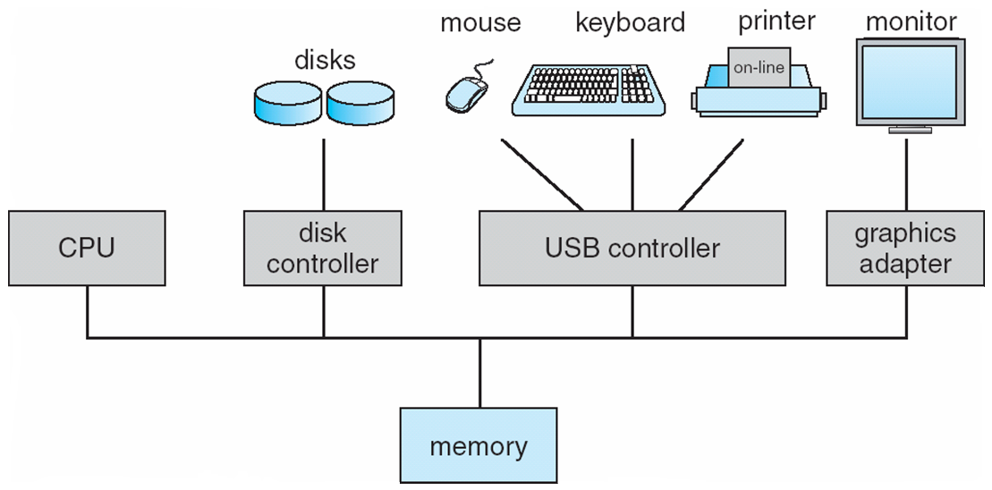
Computer System Organization
Computer-system operation
One or more CPUs, device controllers connect through common bus providing access to shared memory
Each device controller is in charge of a specific device such as disk drives, audio devices etc.

Slide 20
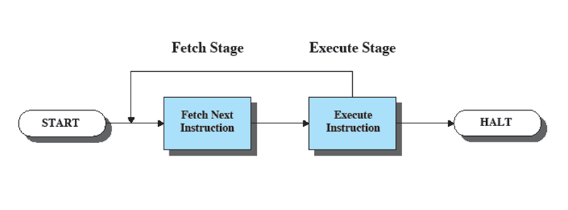
Computer System Organization
Instruction Execution
A program consists of a set of instructions stored in memory
Two steps
Processor reads (fetches) instructions from memory
Processor executes each instruction
Notes:
A program to be executed by a processor consists of a set of instructions stored in memory.
In its simplest form, instruction processing consists of two steps:
The processor reads (fetches) instructions from memory one at a time
and executes each instruction.
Program execution consists of repeating the process of instruction fetch and instruction execution.

Slide 21
Instruction Fetch and Execute
The processor fetches the instruction from memory
Program counter (PC) holds address of the instruction to be fetched next
PC is incremented after each fetch
Fetched instruction loaded into instruction register
Instructions can be:
Processor-memory,
Processor-I/O,
Data processing,
Control
Notes:
At the beginning of each instruction cycle, the processor fetches an instruction from memory.
Typically, the program counter (PC) holds the address of the next instruction to be fetched.
Unless instructed otherwise, the processor always increments the PC after each instruction fetch so that it will fetch the next instruction in sequence (i.e., the instruction located at the next higher memory address).

Slide 22
Computer System Operation
I/O devices and the CPU can execute concurrently
Each device controller is in charge of a particular device type; Each device controller has a local buffer
CPU moves data from/to main memory to/from local buffers; I/O is from the device to local buffer of controller
Device controller informs CPU that it has finished its operation by causing an interrupt

Slide 23
I/O Structure
Storage is only one type of I/O devices
Large OS code is dedicated to manage I/O
Device Controllers
Controls one or more devices. E.g. SCSI controller.
Each controller has local buffer storage and special purpose registers.
Responsible for moving data between peripheral devices and local storage buffer.
OS has device driver for each controller.
Driver understands the controller and present a uniform interface to the device to rest of OS.
Device Drivers: Details from Book (Page 12)

Slide 24
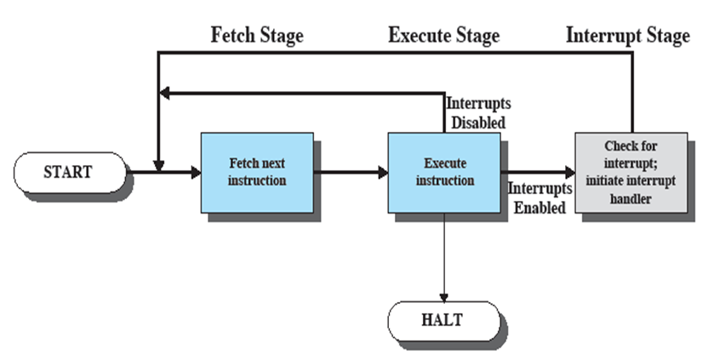
Instruction Cycle with Interrupts
Notes:
To accommodate interrupts, an interrupt stage is added to the instruction cycle, as shown here (compare Figure 1.2 earlier).
In the interrupt stage, the processor checks to see if any interrupts have occurred, indicated by the presence of an interrupt signal.
If no interrupts are pending, the processor proceeds to the fetch stage and fetches the next instruction of the current program.
If an interrupt is pending, the processor suspends execution of the current program and executes an interrupt-handler routine.
The interrupt-handler routine is generally part of the OS.
Typically, this routine determines the nature of the interrupt and performs whatever actions are needed.
In the example we have been using, the handler determines which I/O module generated the interrupt and may branch to a program that will write more data out to that I/O module.
When the interrupt-handler routine is completed, the processor can resume execution of the user program at the point of interruption.

Slide 25
Interrupts
Interrupt the normal sequencing of the processor
Provided to improve processor utilization
Most I/O devices are slower than the processor
Processor must pause to wait for device
Notes:
Virtually all computers provide a mechanism by which other modules (I/O, memory) may interrupt the normal sequencing of the processor.
Interrupts are provided primarily as a way to improve processor utilization.
For example,most I/O devices are much slower than the processor.
Suppose that the processor is transferring data to a printer using the instruction cycle scheme described earlier.
After each write operation, the processor must pause and remain idle until the printer catches up.
The length of this pause may be on the order of many thousands or even millions of instruction cycles.
Clearly, this is a very wasteful use of the processor.

Slide 26
Common Functions of Interrupts
Interrupt transfers control to a fixed location. That fixed location contains address of interrupt service routine.
After service routine is executed, CPU resumes interrupted execution.
Various Interrupt Mechanisms
A generic routine to examine interrupt information. That would call the interrupt specific handler.
It can be handled through the interrupt vector, which contains the addresses of all the service routines

Slide 27
Interrupt Handling
Interrupt architecture must save the address of the interrupted instruction
The operating system preserves the state of the CPU by storing registers and the program counter

Slide 28
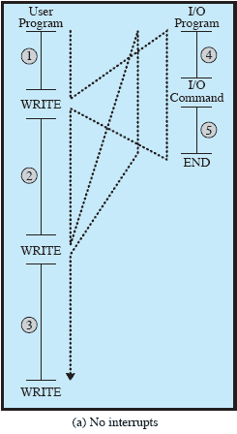
Flow of Control without Interrupts
Notes:
NB: Animated slide showing each stage one at a time.
A) No Interrupts
Figure 1.5a illustrates this previous printer example.
The user program performs a series of WRITE calls interleaved with processing.
The solid vertical lines represent segments of code in a program.
Code segments 1, 2, and 3 refer to sequences of instructions that do not involve I/O.
The WRITE calls are to an I/O routine that is a system utility and that will perform the actual I/O operation.
The I/O program consists of three sections:
• A sequence of instructions, labeled 4 in the figure, to prepare for the actual I/O operation.
This may include copying the data to be output into a special buffer and preparing the parameters for a device command.
• The actual I/O command.
Without the use of interrupts, once this command is issued, the program must wait for the I/O device to perform the requested function (or periodically check the status, or poll, the I/O device).
The program might wait by simply repeatedly performing a test operation to determine if the I/O operation is done.
• A sequence of instructions, labeled 5 in the figure, to complete the operation.
This may include setting a flag indicating the success or failure of the operation.
The dashed line represents the path of execution followed by the processor;
i.e. , this line shows the sequence in which instructions are executed.
Thus, after the first WRITE instruction is encountered, the user program is interrupted and execution continues with the I/O program.
After the I/O program execution is complete, execution resumes in the user program immediately following the WRITE instruction.
Because the I/O operation may take a relatively long time to complete, the I/O program is hung up waiting for the operation to complete;
hence, the user program is stopped at the point of the WRITE call for some considerable period of time.

Slide 29
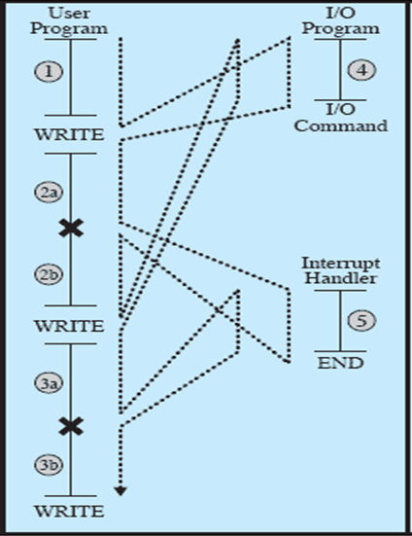
Interrupts and the Instruction Cycle
Notes:
With interrupts, the processor can be engaged in executing other instructions while an I/O operation is in progress.
As before, the user program reaches a point at which it makes a system call in the form of a WRITE call.
The I/O program that is invoked in this case consists only of the preparation code and the actual I/O command.
After these few instructions have been executed, control returns to the user program.
Meanwhile, the external device is busy accepting data from computer memory and printing it.
This I/O operation is conducted concurrently with the execution of instructions in the user program.
When the external device becomes ready to be serviced, that is, when it is ready to accept more data from the processor, the I/O module for that external device sends an interrupt request signal to the processor.
The processor responds by suspending operation of the current program; branching off to a routine to service that particular I/O device, known as an interrupt handler; and resuming the original execution after the device is serviced.
The points at which such interrupts occur are indicated by X in Figure 1.5b.
Note that an interrupt can occur at any point in the main program, not just at one specific instruction.

Slide 30
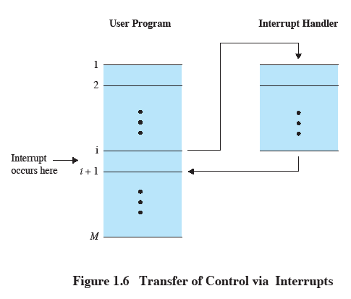
Transfer of Control via Interrupts
Notes:
For the user program, an interrupt suspends the normal sequence of execution.
When the interrupt processing is completed, execution resumes.
Thus, the user program does not have to contain any special code to accommodate interrupts;
the processor and the OS are responsible for suspending the user program and then resuming it at the same point.

Slide 31
Multiple Interrupts
Suppose an interrupt occurs while another interrupt is being processed.
E.g. printing data being received via communications line.
Two approaches:
Disable interrupts during interrupt processing
Use a priority scheme.
Notes:
Suppose that one or more interrupts can occur while an interrupt is being processed.
E.G. , a program may be receiving data from a communications line and printing results at the same time.
The printer will generate an interrupt every time that it completes a print operation.
The communication line controller will generate an interrupt every time a unit of data arrives.
Two approaches can be taken to dealing with multiple interrupts.
The first is to disable interrupts while an interrupt is being processed.
A disabled interrupt simply means that the processor ignores any new interrupt request signal.
If an interrupt occurs during this time, it generally remains pending and will be checked by the processor after the processor has re-enabled interrupts.
A second approach is to define priorities for interrupts and to allow an interrupt of higher priority to cause a lower-priority interrupt handler to be interrupted.

Slide 32
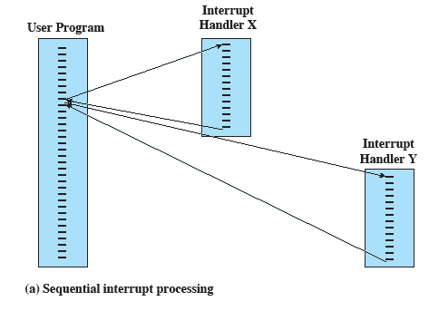
Sequential Interrupt Processing
Notes:
Simple sequential approach to multiple interrupts

Slide 33
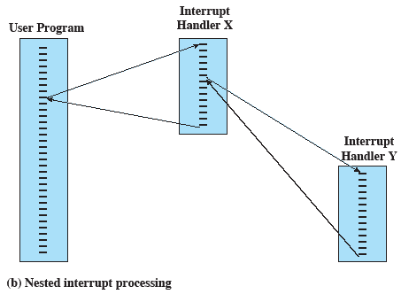
Nested Interrupt Processing
Notes:
Using priorities to “nest” interrupt processing

Slide 34
Storage Structure
Main memory – only large storage media that the CPU can access directly
Random access
Typically volatile
Secondary storage – extension of main memory that provides large nonvolatile storage capacity
Magnetic disks – rigid metal or glass platters covered with magnetic recording material
Disk surface is logically divided into tracks, which are subdivided into sectors
The disk controller determines the logical interaction between the device and the computer
Self Study

Slide 35
Storage Hierarchy
Storage systems organized in hierarchy
Speed
Cost
Volatility
Caching – copying information into faster storage system; main memory can be viewed as a cache for secondary storage
Self Study

Slide 36
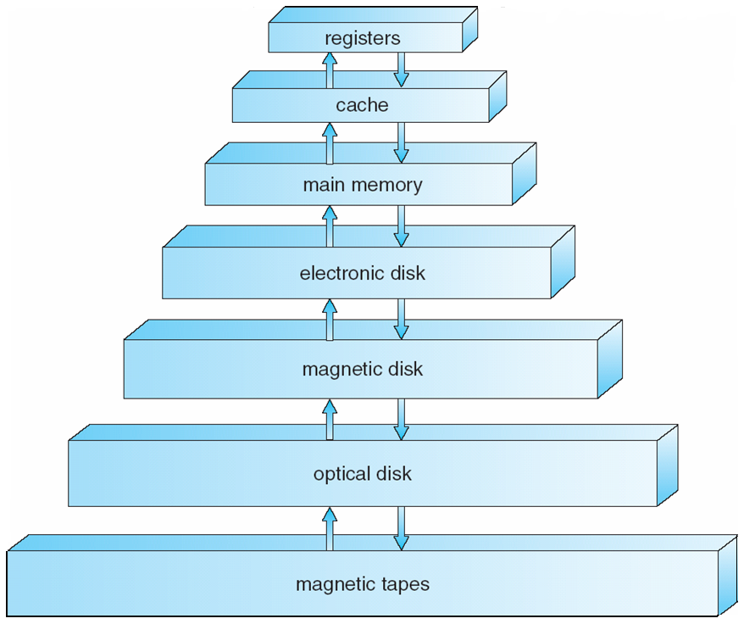
Storage-Device Hierarchy
Self Study

Slide 37
Caching
Principle:
Information in use copied from slower to faster storage temporarily
Faster storage (cache) checked first to determine if information is there
If it is, information used directly from the cache (fast)
If not, data copied to cache and used there
Cache smaller than storage being cached
Cache management important design problem
Cache size and replacement policy
Self Study

Slide 38
Direct Memory Access Structure
Used for high-speed I/O devices able to transmit information at close to memory speeds
Device controller transfers blocks of data from buffer storage directly to main memory without CPU intervention
Only one interrupt is generated per block, rather than the one interrupt per byte
Self Study

Slide 39
Chapter 1: Roadmap
What Operating Systems Do
Computer-System Organization
Computer-System Architecture
Operating-System Structure
Operating-System Operations
Process Management
Memory Management
Storage Management

Slide 40
Computer-System Architecture
Single-Processor Systems
Single General Purpose Processor: Most systems use CPU. System vary from PDAs through mainframes).
Most systems have special-purpose processors as well (graphics controller, disk and keyboard controllers etc)
Special purposes processors run a limited instruction set and do not run user processes.
OS sends them instruction for the next task and monitors their status. (e.g. disk controllers, having their own queue and scheduling algorithm)
Microprocessor in keyboard to convert keystrokes into codes to be sent to CPU.

Slide 41
Computer-System Architecture
Multiprocessors systems growing in use and importance
Also known as parallel systems, tightly-coupled systems
Have two or more processors in close communication, sharing the computer bus and sometimes clock, memory and peripheral devices.
Advantages of multiprocessors include:
Increased throughput
More work in less time, but speed up ratio is not necessarily N times. (overhead of synchronization, contention for share resources)
Economy of scale
Multiprocessors cost less than more systems with equal processors
Increased reliability
The failure of one processor will not halt the function of system

Slide 42
Computer-System Architecture
Multiprocessors
Two types:
Asymmetric Multiprocessing
Each processor is assigned a specific task.
Master processor controls the system; other processors look to master for instructions or have predefined tasks.
The master allocates and schedules work to the slave processors.
Symmetric Multiprocessing
Each processor performs all tasks within OS.
All processors are peers, no masters no slaves.
Intially, Solaris provided the support but now all modern OS provide support for this.
Problems may occur (Load variance). Solution: processor share certain data structures.
SMP and ASMP may be at Hardware and Software levels. Softwares can be written to allow only one master and multiple slaves. E.g. Sun’s SunOS v 5 (Solaris) is symmetric and SunOS v4 provided asymmetric multiprocessing.

Slide 43
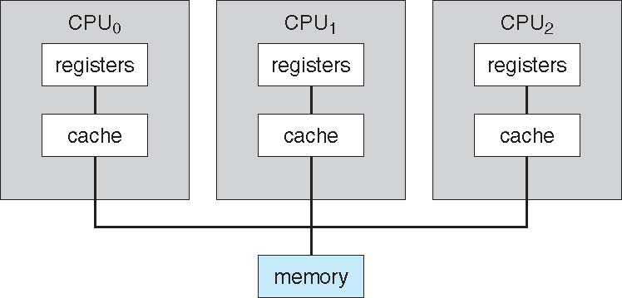
Symmetric Multiprocessing Architecture

Slide 44
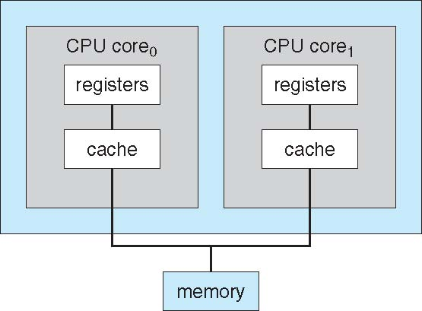
A Dual-Core Design
Multiple Computing Cores on single chip (multiprocessor chips)
More efficient, (less power, faster on chip communication)

Slide 45
Clustered Systems
Like multiprocessor systems, but multiple independent systems working together
No exact definition/structure; general agreed upon definition is: multiple systems connected via LAN and sharing storage.
Usually sharing storage via a storage-area network (SAN)
Provides a high-availability service which survives failures
A layer of cluster software runs on the cluster nodes.
Asymmetric clustering has one machine in hot-standby mode (does nothing but monitors the active server; if server fails, hot standby machine becomes the server); others running the applications.
Symmetric clustering has multiple nodes running applications, monitoring each other
Some clusters are for high-performance computing (HPC)
Applications must be written to use parallelization

Slide 46
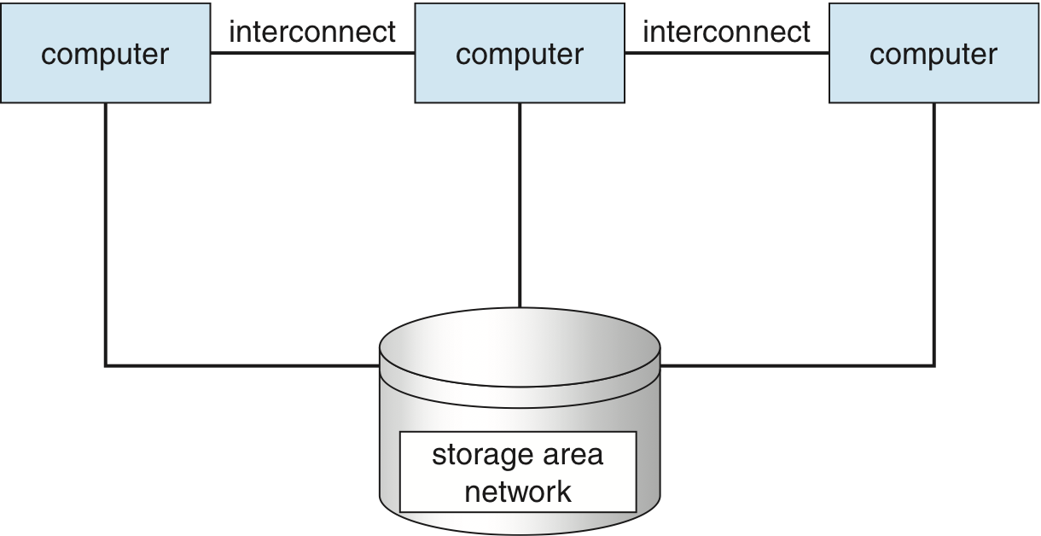
Clustered Systems

Slide 47
Chapter 1: Roadmap
What Operating Systems Do
Computer-System Organization
Computer-System Architecture
Operating-System Structure
Operating-System Operations
Process Management
Memory Management
Storage Management

Slide 48

Uni-programming
Processor must wait for I/O instruction to complete before preceding
Notes:
In a single application system, uniprogramming, the processor spends a certain amount of time executing, until it reaches an I/O instruction.
It must then wait until that I/O instruction concludes before proceeding.
This inefficiency is not necessary.

Slide 49
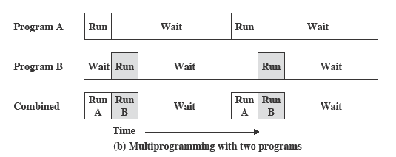
Multiprogramming
When one job needs to wait for I/O, the processor can switch to the other job
Notes:
We know that there must be enough memory to hold the OS (resident monitor) and one user program.
Suppose that there is room for the OS and two user programs.
When one job needs to wait for I/O, the processor can switch to the other job, which is likely not waiting for I/O (Figure 2.5b).

Slide 50
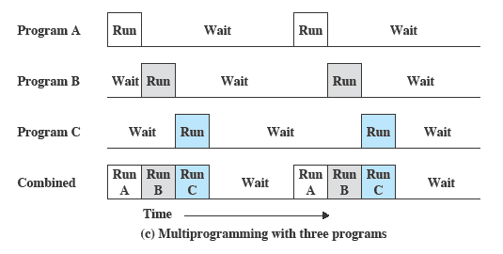
Multiprogramming
Notes:
Further-more, we might expand memory to hold three, four, or more programs and switch among all of them (Figure 2.5c).
The approach is known as multiprogramming, or multitasking.
It is the central theme of modern operating systems.

Slide 51
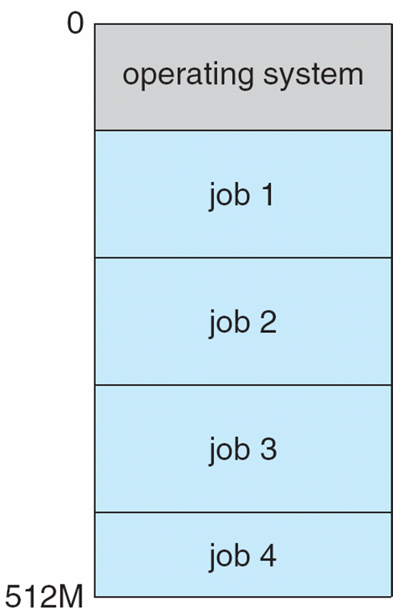
Memory Layout for Multi-programmed System

Slide 52
Multiprogramming
Multiprogramming needed for efficiency
Single user cannot keep CPU and I/O devices busy at all times
Multiprogramming organizes jobs (code and data) so CPU always has one to execute
Jobs are kept initially on disk in job pool. This pool consists of all processes residing on disk awaiting allocation of main memory.
A subset of total jobs in system is kept in memory
One job selected and run via job scheduling
When it has to wait (for I/O for example), OS switches to another job

Slide 53
Time Sharing Systems
Using multiprogramming to handle multiple interactive jobs
Processor’s time is shared among multiple users
Multiple users simultaneously access the system through terminals
Notes:
With the use of multiprogramming, batch processing can be quite efficient.
However, for many jobs, it is desirable to provide a mode in which the user interacts directly with the computer.
Indeed, for some jobs, such as transaction processing, an interactive mode is essential.
Today, the requirement for an interactive computing facility can be, and often is, met by the use of a dedicated personal computer or workstation.
That option was not available in the 1960s, when most computers were big and costly.
Instead, time sharing was developed.
The technique is referred to as time sharing, because processor time is shared among multiple users.
In a time-sharing system, multiple users simultaneously access the system through terminals, with the OS interleaving the execution of each user program in a short burst or quantum of computation.

Slide 54
Time Sharing Systems
Timesharing (multitasking) is logical extension in which CPU switches jobs so frequently that users can interact with each job while it is running, creating interactive computing
Response time should be very short (< 1 second typically)
Each user has at least one program executing in memory process
If several jobs ready to run at the same time  CPU scheduling
If processes don’t fit in memory, swapping moves them in and out to run
Virtual memory allows execution of processes not completely in memory
Also it abstracts main memory into a large uniform array of storage, separating logical memory as viewed by user from physical memory.

Slide 55
Chapter 1: Roadmap
What Operating Systems Do
Computer-System Organization
Computer-System Architecture
Operating-System Structure
Operating-System Operations
Process Management
Memory Management
Storage Management

Slide 56
Operating-System Operations
Modern OS are Interrupt driven.
Events are signaled by occurrence of an interrupt or trap.
Software error or request creates trap
Division by zero, invalid memory access, request for operating system service
For each type of interrupt, separate segments of code in the OS determine which action should be taken (Interrupt Service Routine).
Make sure an error in one a user program could cause problems for only 1 program running.
Problems include infinite loop, processes modifying each other or the operating system

Slide 57
Operating-System Operations
Must be able to differentiate between execution of OS code and user defined code.
Dual-mode operation allows OS to protect itself and other system components
User mode and kernel mode
Mode bit provided by hardware
Provides ability to distinguish when system is running user code or kernel code
Some instructions designated as privileged, only executable in kernel mode
System call changes mode to kernel, return from call resets it to user
Notes:
Must be able to differentiate between execution of OS code and user defined code.
Most computer systems provide hardware support to differentiate between different modes.
A bit called mode bit is added to hardware of the computer to indicate the current mode.
Two modes are typically used: user mode and kernel mode (also called supervisor mode, system mode, or privileged mode)
When a user application runs, system is in user mode.
When a user application requests a service from operating system (via a system call), it must tranition from user to kernel mode.

Slide 58
Operating-System Operations
At startup, system starts in kernel mode.
OS is loaded and then starts application in user mode.
Whenever trap or interrupt occurs, the hardware switches to kernel mode.
Kernel Mode
Machine instructions that may cause harm: Privileged instructions. E.g. I/O control, timer management, interrupt management.
Dual mode protects OS from errant users, and errant users from one another
Notes:
Must be able to differentiate between execution of OS code and user defined code.
Most computer systems provide hardware support to differentiate between different modes.
A bit called mode bit is added to hardware of the computer to indicate the current mode.
Two modes are typically used: user mode and kernel mode (also called supervisor mode, system mode, or privileged mode)
When a user application runs, system is in user mode.
When a user application requests a service from operating system (via a system call), it must tranition from user to kernel mode.

Slide 59
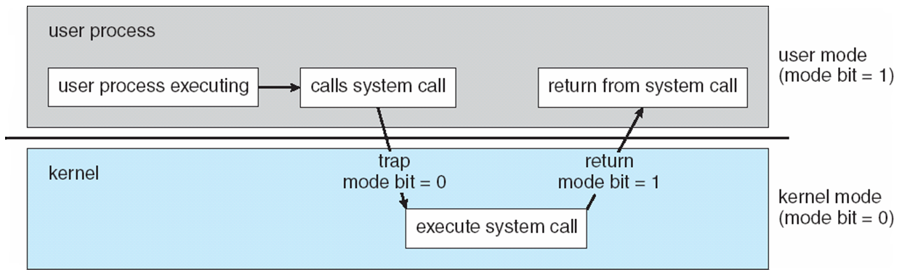
Transition from User to Kernel Mode

Slide 60
Transition from User to Kernel Mode
Must ensure OS maintains control over CPU.
Timer to prevent infinite loop / process hogging resources
Set interrupt after specific period (fixed or variable)
Variable Counter: Fixed clock rate and a counter. OS decrements counter on every clock tick. When counter zero generate an interrupt
Before turning control over to the user, the OS sets up a timer to interrupt. If timer interrupts, control transfers to OS.

Slide 61
Chapter 1: Roadmap
What Operating Systems Do
Computer-System Organization
Computer-System Architecture
Operating-System Structure
Operating-System Operations
Process Management
Memory Management
Storage Management

Slide 62
Process Management
A process is a program in execution. It is a unit of work within the system. Program is a passive entity, process is an active entity.
Process needs resources to accomplish its task
CPU, memory, I/O, files
Initialization data
Process termination requires reclaim of any reusable resources

Slide 63
Components of a Process
A process consists of
An executable program
Associated data needed by the program
Execution context of the program (or “process state”)
The execution context contains all information the operating system needs to manage the process
Notes:
We can think of a process as consisting of three components:
• An executable program
• The associated data needed by the program (variables, work space, buffers, etc.)
• The execution context of the program
This last element is essential.
The execution context, or process state, is the internal data by which the OS is able to supervise and control the process.
This internal information is separated from the process, because the OS has information not permitted to the process.
The context includes all of the information that the OS needs to manage the process and that the processor needs to execute the process properly including:
contents of the various processor registers, such as the program counter and data registers
And information of use to the OS, such as the priority of the process and whether the process is waiting for the completion of a particular I/O event.

Slide 64
Process Management
Single-threaded process has one program counter specifying location of next instruction to execute
Process executes instructions sequentially, one at a time, until completion
Multi-threaded process has one program counter per thread
Typically system has many processes, some user, some operating system running concurrently on one or more CPUs
Concurrency by multiplexing the CPUs among the processes / threads

Slide 65
Process Management Activities
The operating system is responsible for the following activities in connection with process management:
Creating and deleting both user and system processes
Suspending and resuming processes
Providing mechanisms for process synchronization
Providing mechanisms for process communication
Providing mechanisms for deadlock handling

Slide 66
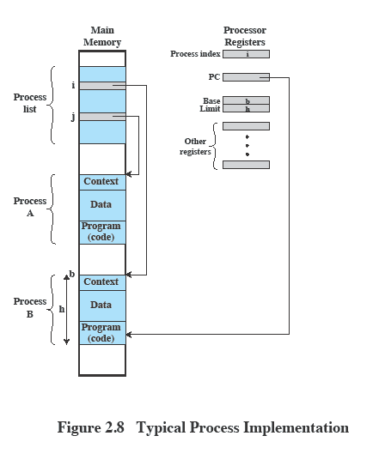
Process Management
Notes:
This figure indicates a way in which processes may be managed.
Two processes, A and B, exist in portions of main memory.
i.e. a block of memory is allocated to each process that contains the program, data, and context information.
Each process is recorded in a process list built and maintained by the OS.
The process list contains one entry for each process, which includes a pointer to the location of the block of memory that contains the process.
The entry may also include part or all of the execution context of the process.
The remainder of the execution context is stored elsewhere, perhaps with the process itself (as indicated in this figure) or frequently in a separate region of memory.
The process index register contains the index into the process list of the process currently controlling the processor.
The program counter points to the next instruction in that process to be executed.
The base and limit registers define the region in memory occupied by the process:
The base register is the starting address of the region of memory and the limit is the size of the region (in bytes or words).
The program counter and all data references are interpreted relative to the base register and must not exceed the value in the limit register.
This prevents interprocess interference.
In Figure 2.8, the process index register indicates that process B is executing.
Process A was previously executing but has been temporarily interrupted.
The contents of all the registers at the moment of A’s interruption were recorded in its execution context.
Later, the OS can perform a process switch and resume execution of process A.
The process switch consists of storing the context of B and restoring the context of A.
When the program counter is loaded with a value pointing into A’s program area, process A will automatically resume execution.

Slide 67
Chapter 1: Roadmap
What Operating Systems Do
Computer-System Organization
Computer-System Architecture
Operating-System Structure
Operating-System Operations
Process Management
Memory Management
Storage Management

Slide 68
Memory Management
All data in memory before and after processing
All instructions in memory in order to execute
Memory management determines what is in memory when
Optimizing CPU utilization and computer response to users
Memory management activities
Keeping track of which parts of memory are currently being used and by whom
Deciding which processes (or parts thereof) and data to move into and out of memory
Allocating and deallocating memory space as needed

Slide 69
Chapter 1: Roadmap
What Operating Systems Do
Computer-System Organization
Computer-System Architecture
Operating-System Structure
Operating-System Operations
Process Management
Memory Management
Storage Management

Slide 70
Storage Management
OS provides uniform, logical view of information storage
Abstracts physical properties to logical storage unit - file
OS maps files on physical media and accesses these files via storage devices.
Each medium is controlled by device (i.e., disk drive, tape drive)
Varying properties include access speed, capacity, data-transfer rate, access method (sequential or random)

Slide 71
Storage Management
File-System management
File is collection of related information defined by its creator.
Files represent programs, data.
Files may be free-form or rigidly formatted.
Files usually organized into directories
Access control on most systems to determine who can access what
OS activities include
Creating and deleting files and directories
Primitives to manipulate files and directories
Mapping files onto secondary storage
Backup files onto stable (non-volatile) storage media

Slide 72
Storage Management
Mass-Storage Management
Usually disks used to store data that does not fit in main memory or data that must be kept for a “long” period of time
Proper management is of central importance
Entire speed of computer operation hinges on disk subsystem and its algorithms
OS activities
Free-space management
Storage allocation
Disk scheduling

Slide 73
Storage Management
Some storage need not be fast
Tertiary storage includes optical storage, magnetic tape
Still must be managed – by OS or applications
Varies between WORM (write-once, read-many-times) and RW (read-write)

Slide 74
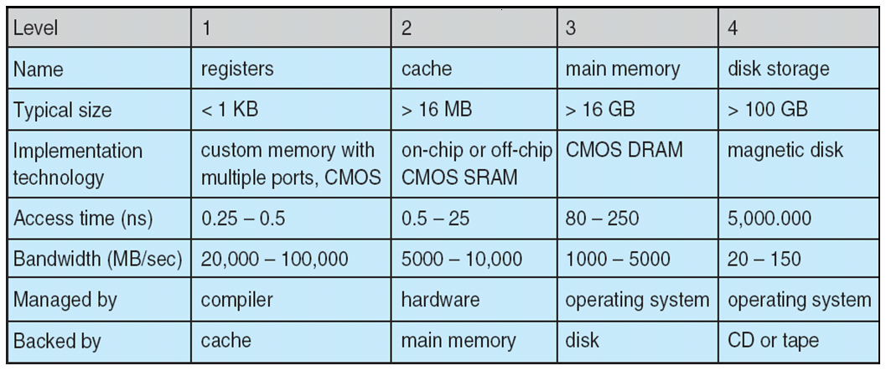
Storage Management
Performance of various levels of storage
Movement between levels of storage hierarchy can be explicit or implicit

Slide 75
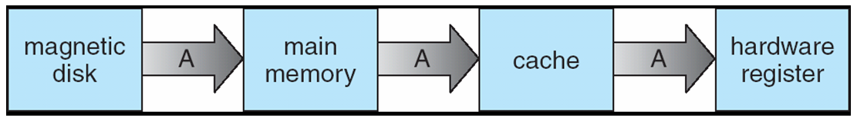
Storage Management
Migration of Integer A from Disk to Register
Multitasking environments must be careful to use most recent value, no matter where it is stored in the storage hierarchy Multiprocessor environment must provide cache coherency in hardware such that all CPUs have the most recent value in their cache
Distributed environment situation even more complex
Several copies of a datum can exist

Slide 76
Storage Management
I/O System
One purpose of OS is to hide peculiarities of hardware devices from the user
I/O subsystem responsible for
Memory management of I/O including buffering (storing data temporarily while it is being transferred), caching (storing parts of data in faster storage for performance), spooling (the overlapping of output of one job with input of other jobs)
General device-driver interface
Drivers for specific hardware devices

